Slide 1

Programming the Android Platform
User Interface Classes
(Notes#4)

Slide 2
Outline
Design Principles
Views & Layouts
Event Handling
Menus
Dialogs

Slide 3
Android User Interfaces
Activities usually include a user interface
Android provides many classes for constructing user interfaces

Slide 4
The View Class
Building block for UI components
Views occupy a rectangular space on screen
Responsible for drawing themselves and for handling events
Common operations
Set properties
Set focus
Attach Listeners
Set visibility

Slide 5
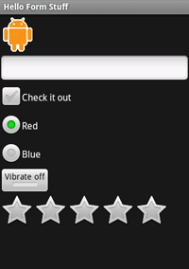
Widgets
Many predefined widgets
Buttons
Text field
Editable text field
Check box
Radio buttons
Toggle Button
Rating Bar

Slide 6
View Event Handling
When user interacts with view, callback methods are invoked
Some examples with simplified description
onClick() – focus & press view
onLongClick() – touch, press & hold view
onFocusChange() – navigate in/out of view
onKey() – focus, press & release key

Slide 7
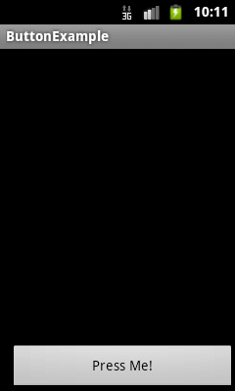
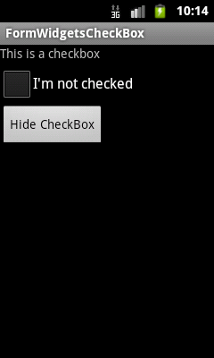
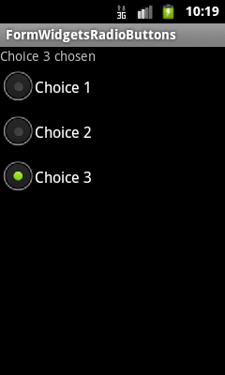
Widgets (cont.)

Slide 8
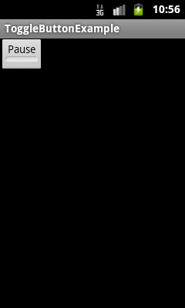

Widgets (cont.)

Slide 9
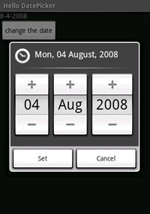
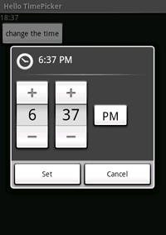
Widgets (cont.)
Date Picker
Time Picker

Slide 10
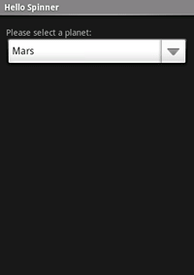
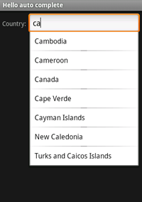

Widgets (cont.)
Spinner
Auto Complete
Gallery

Slide 11
Spinner
Provides a scrollable list of items
User can select one item at a time
Items added to Spinner with a ListAdapter

Slide 12
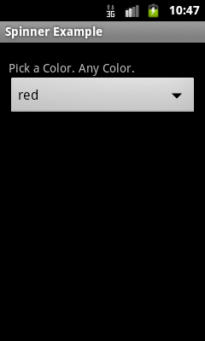
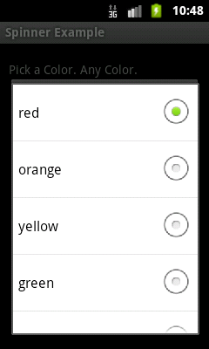
Spinner (cont.)

Slide 13
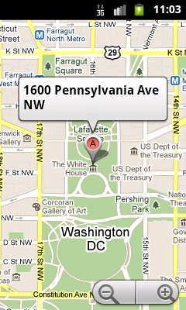
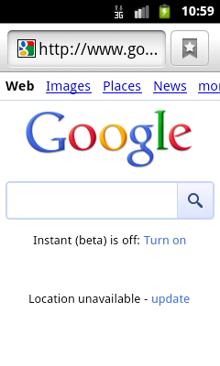
Other Views
MapView
Web View

Slide 14
The ViewGroup Class
A View class that can contain other views
Used for grouping & organizing a set of views
Base class for layouts & view containers

Slide 15
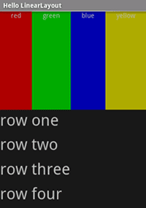
Linear Layout
Child views are arranged in a single horizontal or vertical row

Slide 16
Linear Layout (cont.)
<LinearLayout … android:orientation="vertical"
android:layout_width="fill_parent” android:layout_height="fill_parent”>
<LinearLayout …>
<TextView … red block />
…
<TextView … yellow block />
</LinearLayout …>
<LinearLayout …>
<TextView … row one/>
…
<TextView … row four/>
</LinearLayout …>
</LinearLayout …>

Slide 17
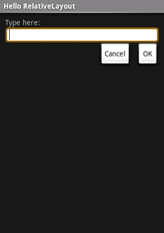
Relative Layout
Child views are positioned relative to each other and to parent view

Slide 18
Relative Layout (cont.)
<RelativeLayout…
android:layout_width="fill_parent” android:layout_height="fill_parent">
<TextView android:id="@+id/label” android:text="Type here:"
android:layout_width="fill_parent” android:layout_height="wrap_content”/>
<EditText android:id="@+id/entry"
android:layout_width="fill_parent” android:layout_height="wrap_content"
android:background="@android:drawable/editbox_background"
android:layout_below="@id/label"/>
<Button android:id="@+id/ok"
android:layout_width="wrap_content” android:layout_height="wrap_content"
android:layout_below="@id/entry” android:layout_alignParentRight="true"
android:layout_marginLeft="10dip"
android:text="OK" />
<Button
android:layout_width="wrap_content” android:layout_height="wrap_content"
android:layout_toLeftOf="@id/ok” android:layout_alignTop="@id/ok"
android:text="Cancel" />
</RelativeLayout>

Slide 19
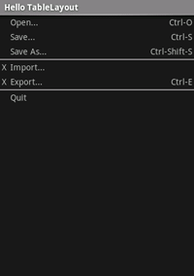
Table Layout
Child views arranged into rows & columns

Slide 20
Table Layout (cont.)
<TableLayout …>
<TableRow>
<TextView android:layout_column="1"
android:text="Open...” android:padding="3dip" />
…
</TableRow>
<View android:layout_height="2dip” android:background="#FF909090" />
<TableRow>
<TextView android:text="X” android:padding="3dip" />
<TextView android:text="Import...” android:padding="3dip" />
…
</TableRow>
<TableLayout …>

Slide 21
Grid View
Child views arranged in a two-dimensional, scrollable grid
Child views added to layout via ListAdapter

Slide 22
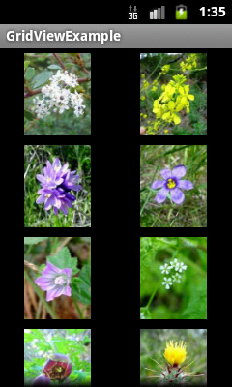

Grid View (cont.)

Slide 23
Tab Layout
Allows multiple Activities to share single content area
Layout is divided into tab & content areas
Each Tab is associated with one Activity
Exactly one tab is selected at any given time
Activity corresponding to the selected tab is visible in the content area

Slide 24
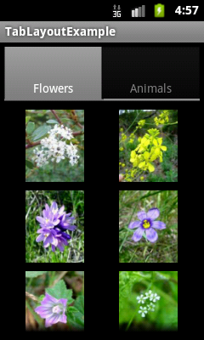
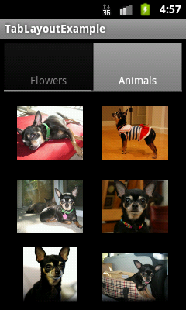
Tab Layout

Slide 25
ListView
ViewGroup containing a scrollable list of items
Items can be selected
ListView can filter list of items based on text input
List items inserted using a ListAdapter

Slide 26
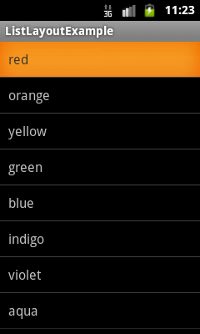
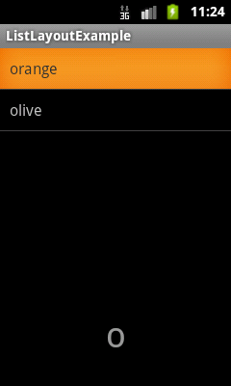
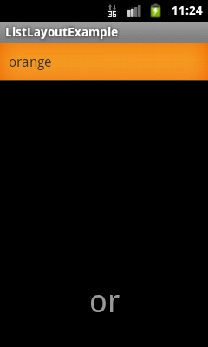
List View

Slide 27
Menus
Activities can include menus
Can add items to a menu
Can handle clicks on the menu items

Slide 28
Menu Types
Options – Primary menu shown when user presses the menu button
Context – View-specific menu to be shown when user touches and holds the view
Submenu – A menu activated when user touches a visible menu item

Slide 29
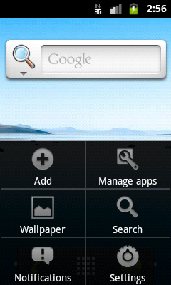
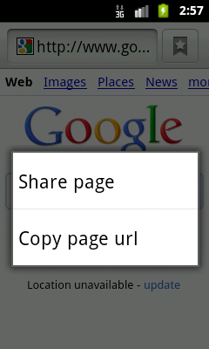
Option & Context Menus

Slide 30
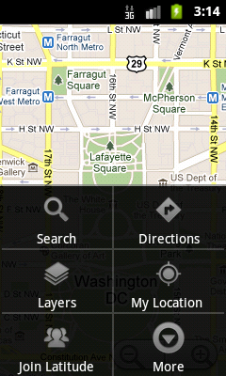
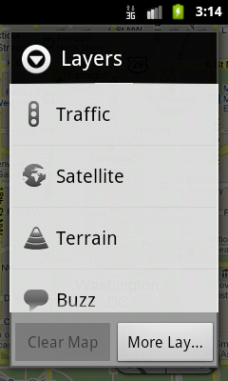
SubMenus

Slide 31
Creating Menus
Define Menu resource in XML file
Store in res/menu/filename.xml
Inflate menu resource using MenuInflater in appropriate onCreate…Menu() methods
Handling item selection in appropropriate on…ItemsSelected() methods

Slide 32
Menus (cont.)
Many other features supported
Grouping menu items
Binding shortcut keys to menu items
Binding Intents to menu items

Slide 33
Dialogs
Independent subwindow used by Activities to communicate with user
Dialog subclasses
AlertDialog
ProgressDialog
DatePickerDialog
TimePickerDialog

Slide 34
AlertDialog
AlertDialog.Builder builder = new AlertDialog.Builder(this);
builder.setMessage(”Do you wish to exit?”) .setCancelable(false) .setPositiveButton("Yes", new DialogInterface.OnClickListener() { public void onClick(DialogInterface dialog, int id) { MyActivity.this.finish(); } }) .setNegativeButton("No", new DialogInterface.OnClickListener() { public void onClick(DialogInterface dialog, int id) { dialog.cancel(); } });
AlertDialog alert = builder.create();
alert.show();

Slide 35
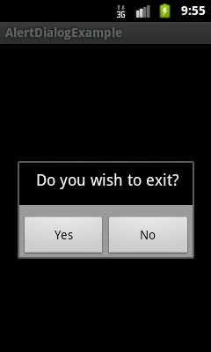
AlertDialog (Cont.)

Slide 36
Process Dialog
ProgressDialog progressDialog = new ProgressDialog(this);
progressDialog.setMessage("Activity Shutting Down.");
progressDialog.show();

Slide 37
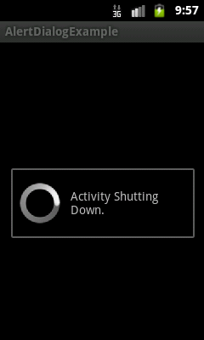
Process Dialog

Slide 38
Lab Assignment

